Slide 1
Monte Carlo the Project That Sank
Devin Larson

Slide 2
AGENDA
Math Background
Approach
Kernel's Deep Dive
Modeling
Fun

Slide 3
Introduction to Monte Carlo
A computational algorithm that relies on repeated random sampling to obtain numerical results.
Step 1: Define a domain of possible inputs.
Step 2: Generate inputs randomly from a probability distribution over the domain.
Step 3: Perform a deterministic computation on the inputs.
Step 4: Aggregate the results.

Slide 4
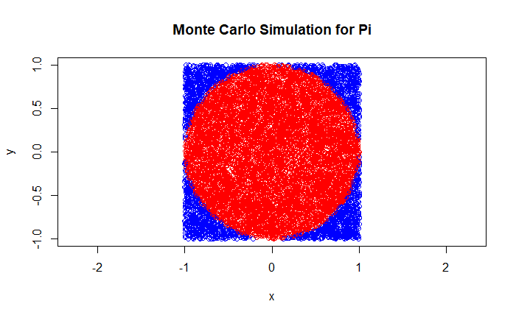
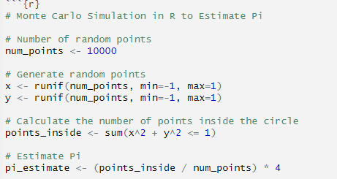
Pi example
Example Code(in R)
Estimated value of Pi: 3.1236"

Slide 5
Process
1st Attempt
CPU IMPLMENTATION in Python
- not scale able to the level I wanted
- ability to carry models was nice
Python Approach
Limited to certain applications hard to debug the GPU side due to more control being taken away through abstraction
Using Python to Call CUDA Kernels
Difficulty in debugging gave up to just use CUDA
CUDA
- a lot of time waisted trying other ways to just use CUDA due to the most control over what I am doing

Slide 6
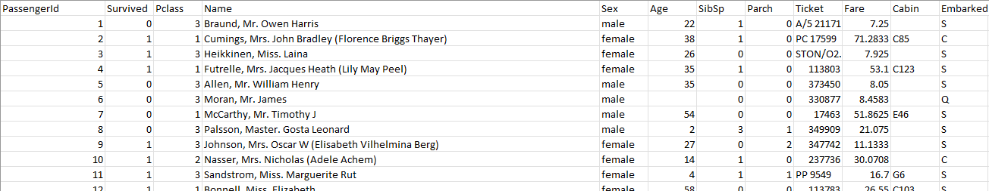
Data Variables(892 People Represented)
Survived is the target variable we are trying to predict (0 or 1):
  1 = Survived
  0 = Not Survived
Pclass (Passenger Class) is the socio-economic status of the passenger and it is a categorical ordinal feature which has 3 unique values (1, 2 or 3):
  1 = Upper Class
  2 = Middle Class
  3 = Lower Class
Name, Sex and Age are self-explanatory
SibSp is the total number of the passengers' siblings and spouse
Parch is the total number of the passengers' parents and children
Ticket is the ticket number of the passenger
Fare is the passenger fare
Embarked is port of embarkation and it is a categorical feature which has 3 unique values (C, Q or S):
  C = Cherbourg
  Q = Queenstown
  S = Southampton

Slide 7
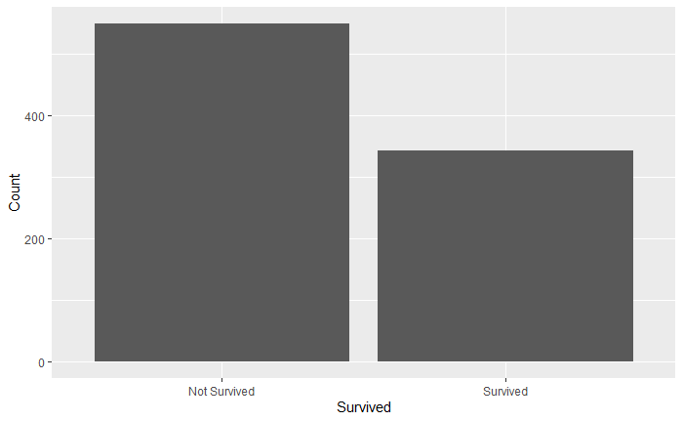
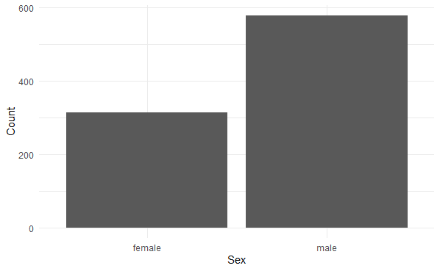
Categorical Distributions(2)

Slide 8
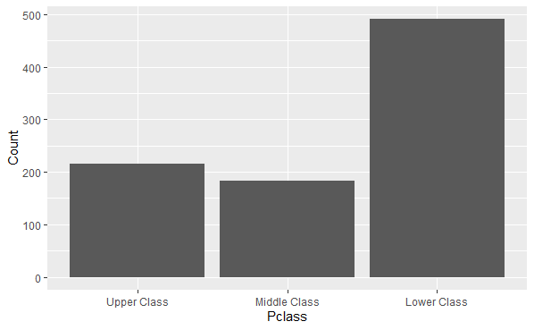
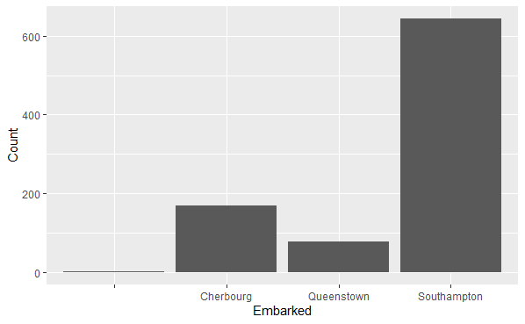
Categorical Distributions(3)

Slide 9
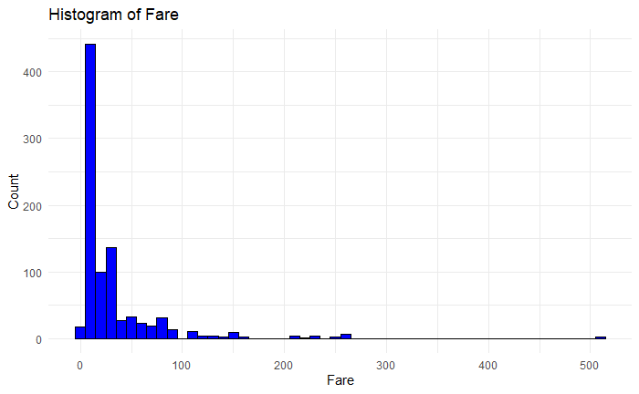
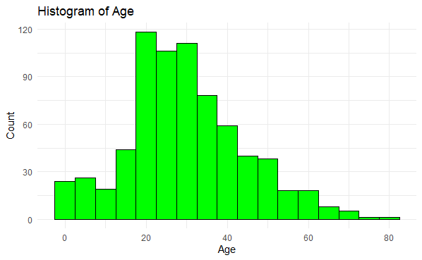
Log- Normal Distributions

Slide 10
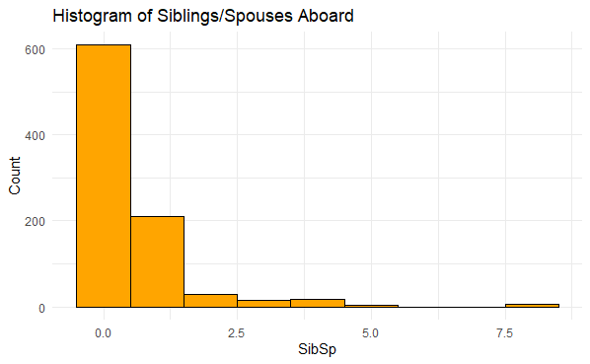
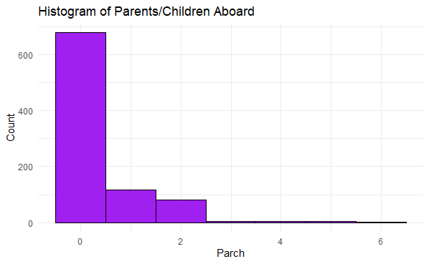
Normal Distributions

Slide 11
Kernels
Side Note All Profiling was done for n = 1 million
Init
Generate Categorical 3
Generate Categorical 2
Generate Log Normal
Generate Normal
Rounding

Slide 12
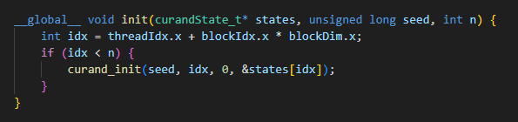
Init
Scalability: Designed for scalability across many threads.
Reproducibility: Consistent initialization allows for reproducible results in simulations.
GPU Only: States never leaves the GPU till it is a variables final form

Slide 13
Init Profling
Initialization Time: 28.115969 ms
Kernel Execution Time: 28.208128 ms
Memory Transfer Time: 0.002048 ms

Slide 14
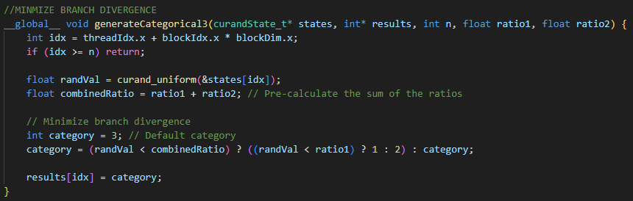
Categorical 3
Generates a uniform random value between 0 and 1 for each trial.
Assigns a category based on the random value and predefined ratios:
Reduced Overhead: Direct computation within GPU, minimizing data transfer between CPU and GPU.
Optimized for Large n: Efficient for large-scale simulations due to parallel execution.

Slide 15
Categorical 3 Profiling
Initialization Time: 28.095488 ms
Kernel Execution Time: 0.002048 ms
Memory Transfer Time: 0.360448 ms
Time for generateCategorical3: 0.355328 ms
Data transferred for generateCategorical3: 4000000 bytes
Bandwidth for generateCategorical3: 10735.707031 MB/s

Slide 16
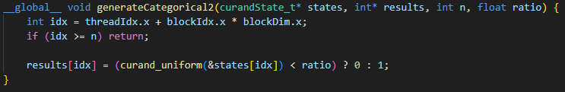
Categorical 2

Slide 17
Categorical 2 Profiling
Initialization Time: 28.098560 ms
Kernel Execution Time: 0.361472 ms
Memory Transfer Time: 2.819296 ms
Time for generateCategorical2: 0.357408 ms
Data transferred: 4000000 bytes
Bandwidth: 10673.228516 MB/s

Slide 18
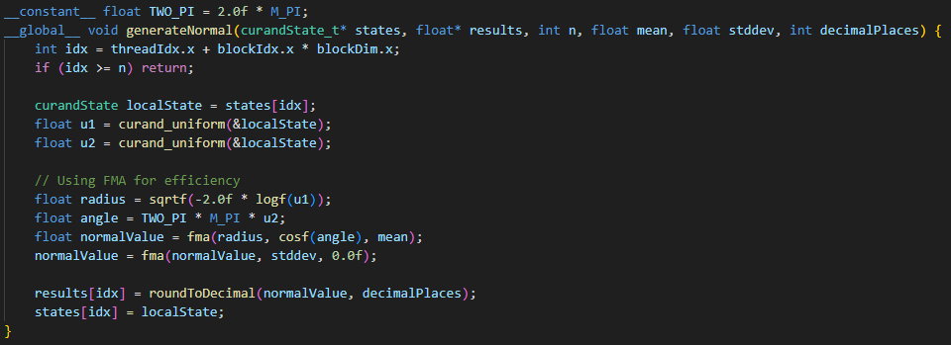
Normal
Utilizes the CURAND library for generating uniform random numbers: curand_uniform(&localState).
Generates two uniform random numbers u1 and u2.
Applies the Box-Muller formula to convert uniform random numbers to a normal distribution:
float normalValue = mean + stddev * sqrt(-2.0 * log(u1)) * cos(2.0 * M_PI * u2);
rounds

Slide 19
Normal Profiling
Initialization Time: 28.228607 ms
Kernel Execution Time: 0.402432 ms
Memory Transfer Time: 2.881728 ms
Time for normal_transform: 0.400384 ms
Data transferred for normal_transform: 4000000 bytes
Bandwidth for normal_transform: 9527.596680 MB/s

Slide 20
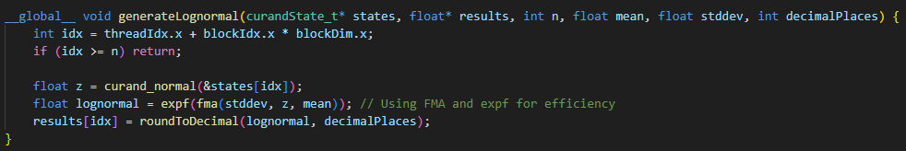
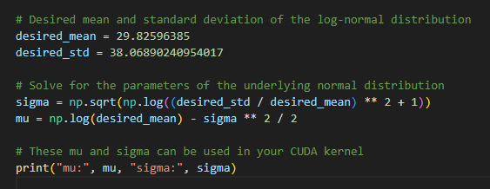
Log Normal
Generates a normally distributed random number z using CURAND: float z = curand_normal(&states[idx]);
Adjusts z to have the specified mean and standard deviation: z = stddev * z + mean;
Applies the exponential function to convert the normal value to a lognormal distribution: float lognormal = exp(z);
Rounds
Maintains CURAND states within the kernel, reducing the need for additional memory operations.
Must got back and calculate for the underlying normal distribution to set correct paramaters

Slide 21
Log Normal Profiling
Initialization Time: 28.150784 ms
Kernel Execution Time: 0.444416 ms
Memory Transfer Time: 2.949568 ms
Time for generateLognormal: 0.430080 ms
Data transferred: 4000000 bytes
Bandwidth: 8869.739258 MB/s

Slide 22
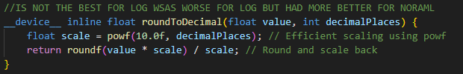
Rounding
Scaling the Value: The function first calculates a scaling factor using powf(10.0f, decimalPlaces). This effectively creates a multiplier to scale the original number. For example, if decimalPlaces is 2, the scale factor will be 100.
Rounding the Scaled Value: The original value is then multiplied by this scale factor, moving the decimal point to the right by decimalPlaces positions. The roundf function is then used to round this scaled value to the nearest integer.
Scaling Back: After rounding, the function scales the value back to its original range by dividing it by the scale factor. This step restores the number to its original range but with the desired number of decimal places.

Slide 23
Rounding Profiling
Roughly 0.006144ms spent running
Inline was a better choice for Normal that over the slow down in log normal

Slide 24
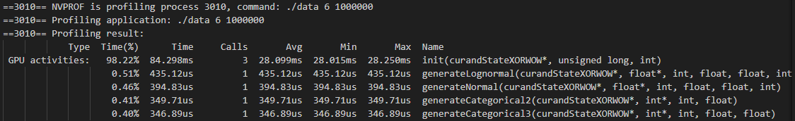
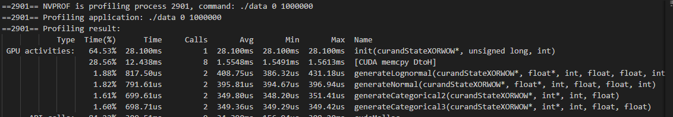
General Profiling

Slide 25
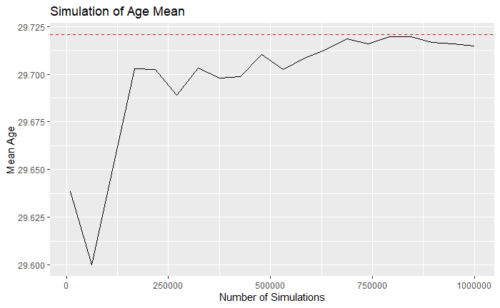
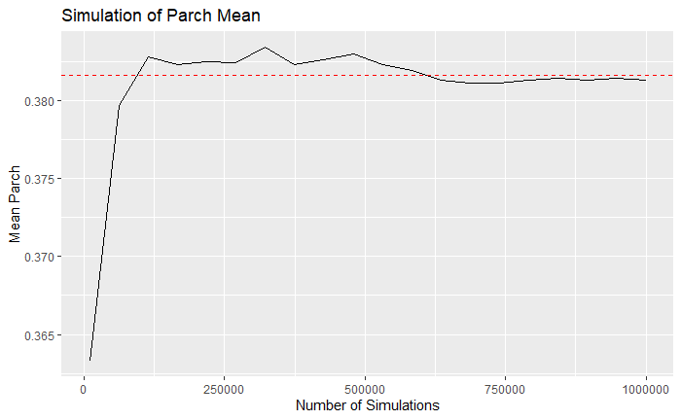
ACCURACY OVER TIME

Slide 26
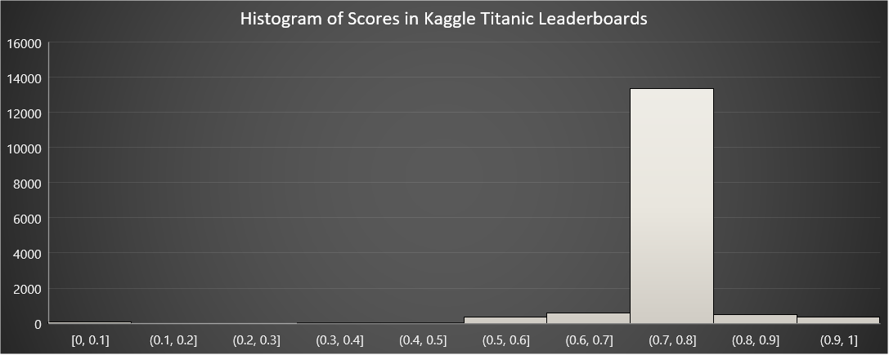
Basis for A decent Model

Slide 27
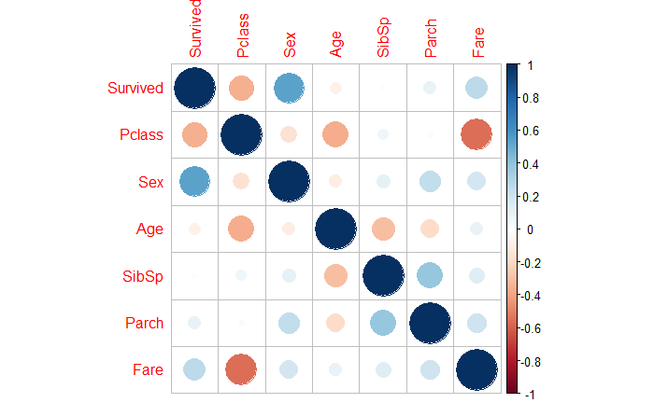
Variable Selection
Variables Selected to use for more tuned modeling
- PClass
- Sex
- Fare

Slide 28
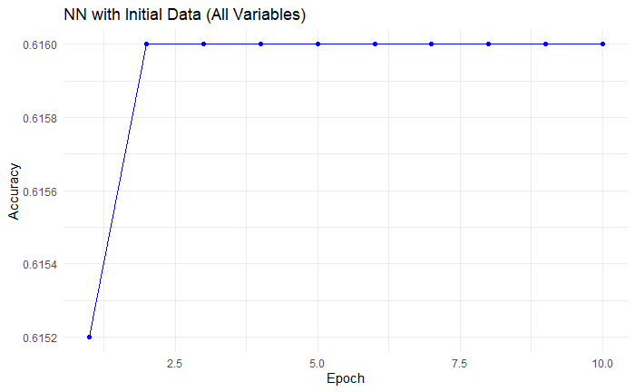
Modeling NORMAL RESULTS
Logistic Regression & Random Forest: High accuracy (0.81) with better precision for non-survivors.
TensorFlow Neural Network: Reaches 0.8045 accuracy, comparable to other models in Titanic dataset classification.

Slide 29
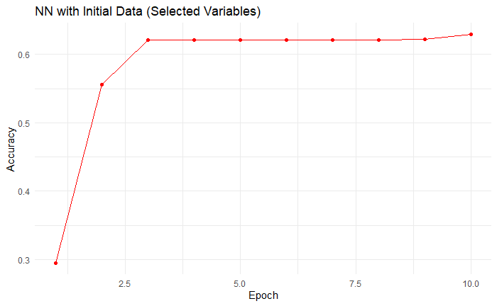
Modeling Normal Results With Variable Selection
Logistic Regression (Variable Selection): Balanced, 0.78 accuracy, better at predicting non-survivors.
Random Forest (Variable Selection): Enhanced accuracy at 0.83, excels in non-survivor predictions.
TensorFlow Neural Network (Variable Selection): Learns effectively, reaching about 74.86% accuracy.

Slide 30
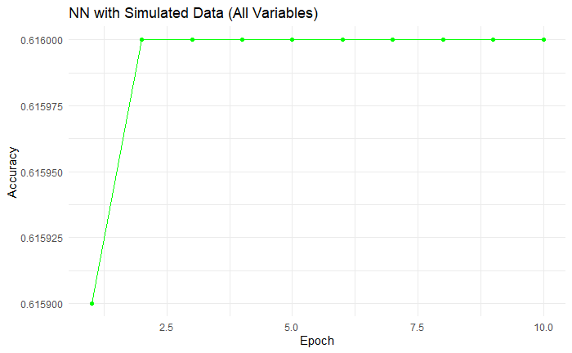
Modeling Synthetic Details
Logistic Regression (Synthetic Data): Biased towards Class 1 (Survived) with 0.62 accuracy; fails to predict Class 0 (Not Survived).
Random Forest (Synthetic Data): Moderately accurate (0.54); better at predicting Class 1 than Class 0, needs model refinement.
TensorFlow Neural Network (Synthetic Data): Moderately accurate (around 0.615); shows early training convergence, suggesting model or data limitations.

Slide 31
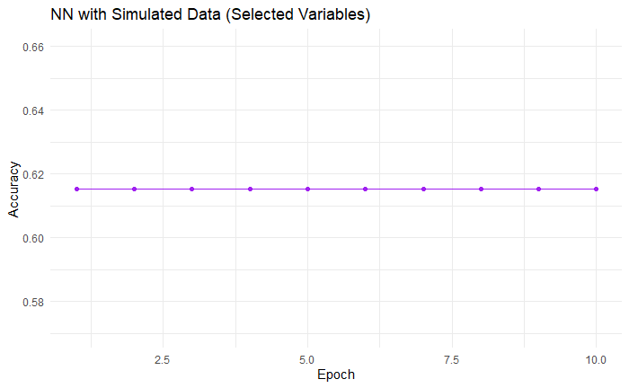
Modeling Synthetic Variable Selection
Logistic Regression on Synthetic Data: High recall for Class 1, fails for Class 0, 62% accuracy, showing bias towards Class 1.
Random Forest on Synthetic Data: Moderate recall for Class 1, low for Class 0, 58% accuracy, slightly more balanced than Logistic Regression.
TensorFlow Neural Network on Synthetic Data: Steady 61.6% accuracy, suggesting moderate performance and possible model/data limitations.

Slide 32


The Sinking of My monte Carlo
Time Constraints and Methodology: Faced with limited time, extensive exploration of various coding methods was prioritized over the application of Markov chain for introducing probabilistic parameters in random data generation. Wanted to start some form of Cholesky Decomposition but ran out of time
Study on Randomness: This research offers intriguing insights into the performance of models under conditions where individuals in the dataset are assigned variables randomly, without any inter-variable correlation.
Simulated Data for Academia and Research: The project underscores the potential of using simulated data in academic and research contexts, particularly for studies focusing on model performance under varying data conditions.

Slide 33
Time FOR FUN
Clone the Repository: Access and clone the provided repository to explore its contents.
Experiment with Data Modeling: Utilize the data modeling, fun, and fun_gpu modules, which offer interactive, Oregon Trail-style experiences in data creation and manipulation.
Demonstration: A walkthrough will be provided to showcase the functionality and features of these modules.
Clone the Repository: Access and clone the provided repository to explore its contents.
Experiment with Data Modeling: Utilize the data modeling, fun, and fun_gpu modules, which offer interactive, Oregon Trail-style experiences in data creation and manipulation.
Demonstration: A walkthrough will be provided to showcase the functionality and features of these modules.
NOTE(Maximum safe N for simultaneous operations approximately: 3,66,090,240)

Slide 34
Reference
https://drive.google.com/file/d/1VmkAAGOYCTORq1wxSQqy255qLJjTNvBI/edit (374)
https://medium.com/@rahul.singh.ds20/synthetic-data-future-of-data-6efd0b06a8ad
https://yingqijing.medium.com/multivariate-normal-distribution-and-cholesky-decomposition-in-stan-d9244b9aa623
https://www.tensorflow.org/guide/keras/sequential_model
https://www.tensorflow.org/api_docs/python/tf/keras/layers/Dense
https://www.sciencedirect.com/topics/mathematics/lognormal-distribution

